Slide 1





THEORY
Training Program 01
Advanced NLP & Large Language Models (LLMs)

Slide 2
THEORY
Training Program 01
M01: Text Preprocessing
M02: Word and Sentence Embeddings
M03: Transformer Architectures
M04: Entity-Centric NLP
M05: Applied NLP Tasks
M06: Multimodal NLP
M07: LLM Fundamentals
M08: Prompt Engineering
M09: Fine-Tuning & PEFT
M10: RAG & Real-World Projects

Slide 3
MODULE M01
TEXT PREPROCESSING
CHAPTER M05
Applied NLP Tasks

Slide 4
THEORY
Training Program 01
5.1 Introduction to Applied NLP Tasks
5.2 Core Task: Text Classification
5.3 Understanding User Intent: Sentiment Analysis
5.4 Reducing Information Overload: Text Summarization
5.5 Information Retrieval: Question Answering Systems
5.6 Task Comparison and the Future of Applied NLP

Slide 5
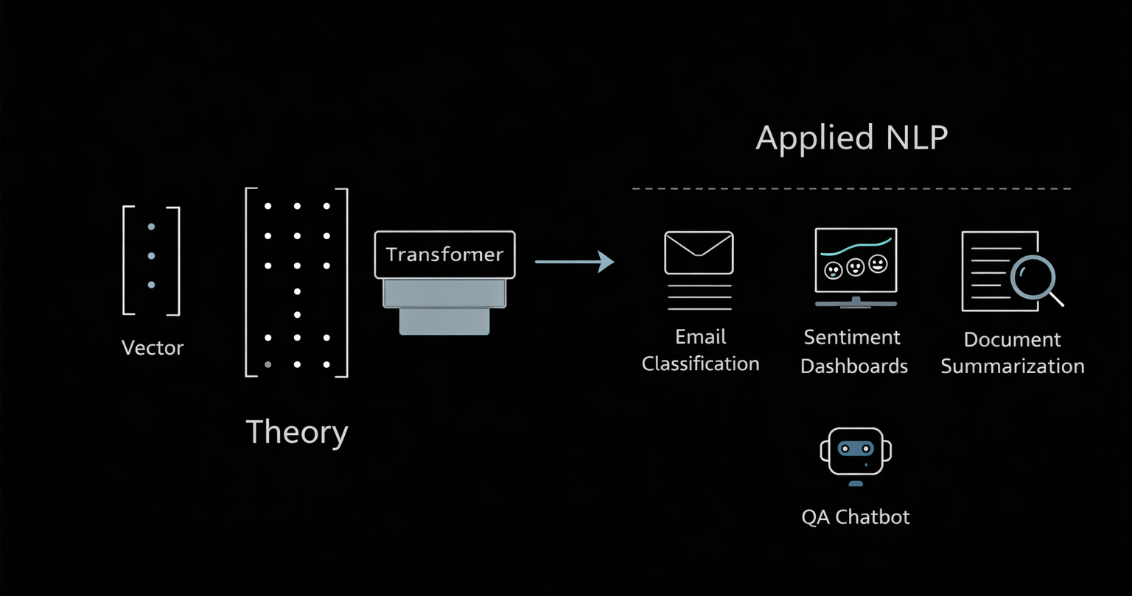
M01.1 BPE
M05
Chapter 5.1 Introduction to Applied NLP Tasks
From Theory to Applied NLP
NLP moves from mathematical modeling to real-world problem solving.
Applied NLP focuses on business, industrial, and societal value.
Models are evaluated by usefulness, not only benchmark scores.
This module connects Transformers to production systems.

Slide 6
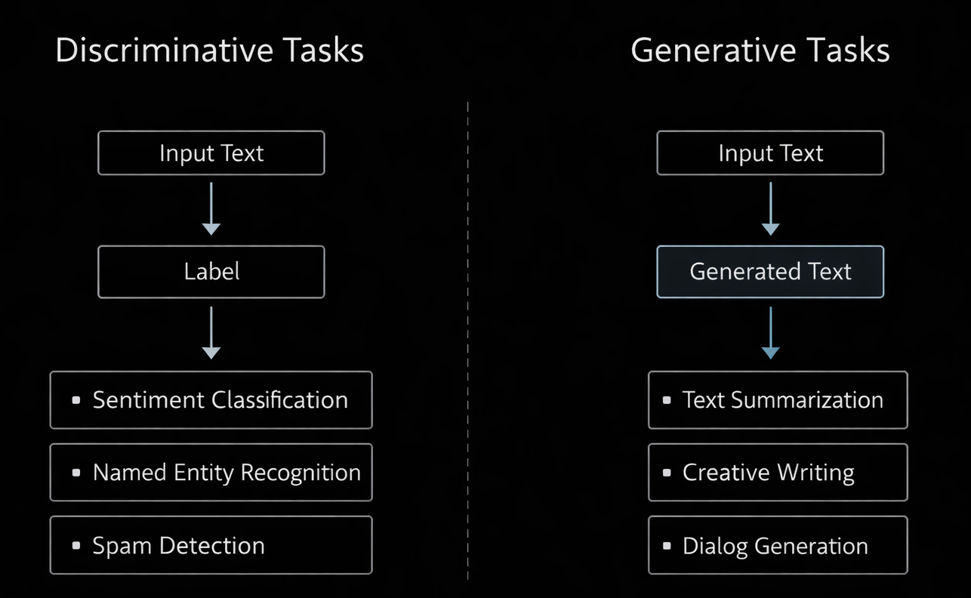
M01.1 BPE
M05
Chapter 5.1 Introduction to Applied NLP Tasks
Applied NLP Task Families
Applied NLP tasks fall into two paradigms
Tasks are defined by what the model produces
Choice impacts architecture, evaluation, and cost

Slide 7
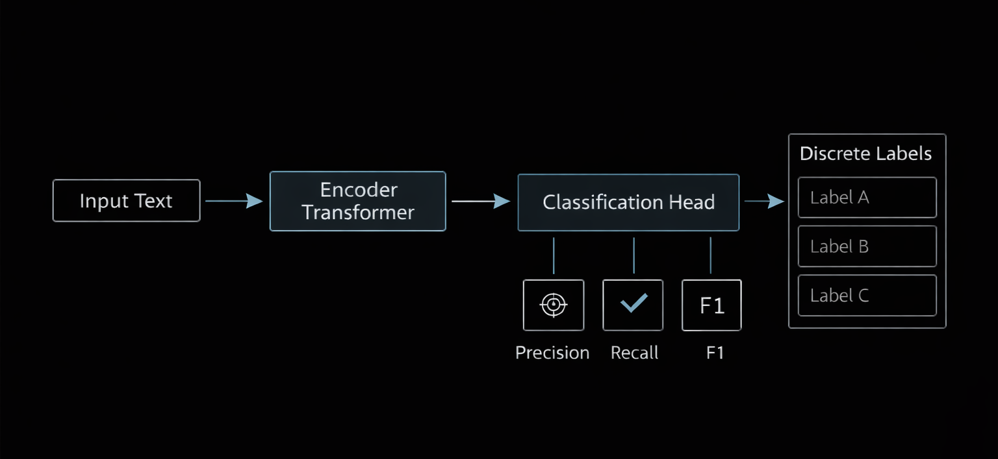
M01.1 BPE
M05
Chapter 5.1 Introduction to Applied NLP Tasks
Discriminative Tasks
Output: predefined labels
Goal: decision, filtering, categorization
Typical architectures: Encoder-only (BERT-style)
Metrics: Accuracy, Precision, Recall, F1-score
Examples: classification, sentiment, NER

Slide 8
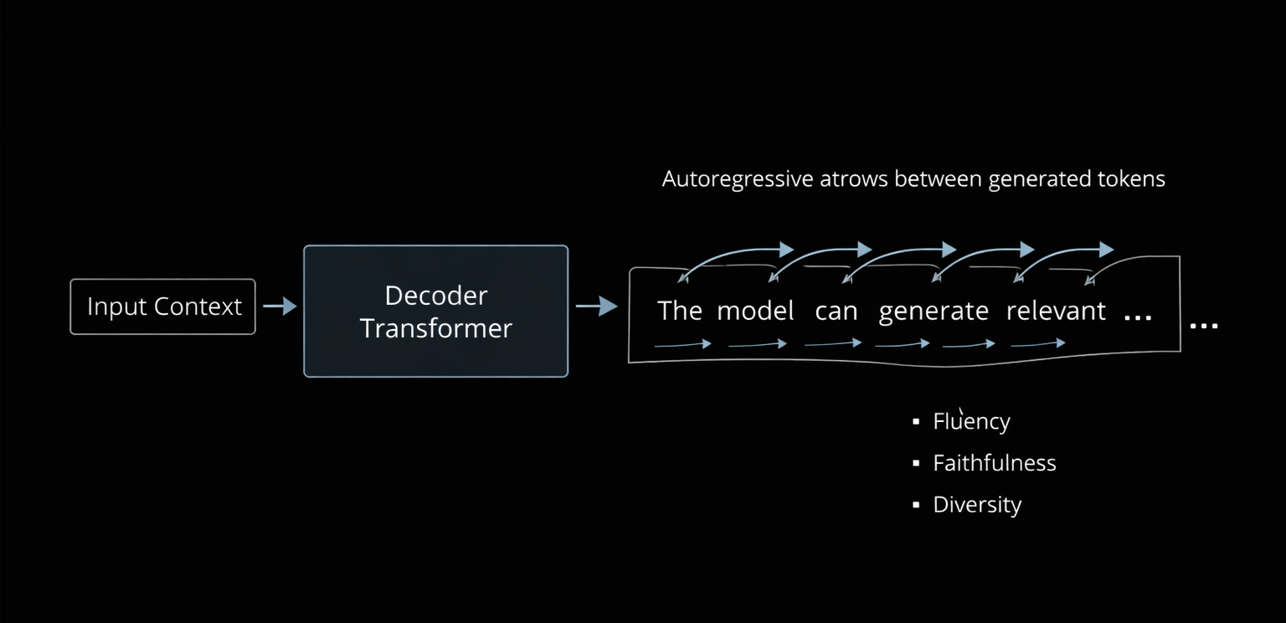
M01.1 BPE
M05
Chapter 5.1 Introduction to Applied NLP Tasks
Generative Tasks
Output: newly generated text
Goal: synthesis, explanation, abstraction
Typical architectures: Decoder or Encoder–Decoder
Evaluation is probabilistic and semantic
Examples: summarization, QA, text generation

Slide 9
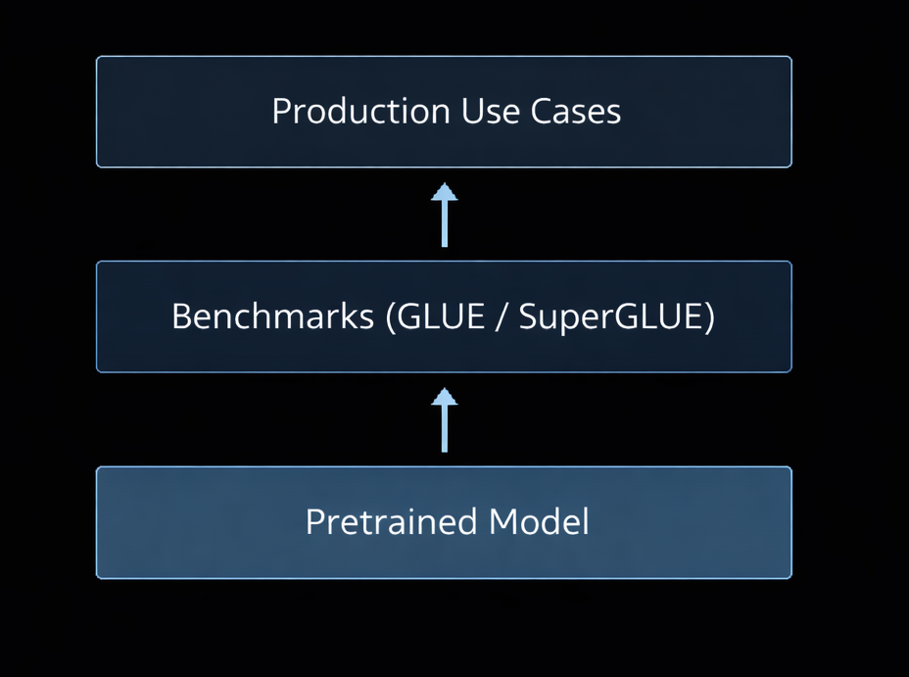
M01.1 BPE
M05
Chapter 5.1 Introduction to Applied NLP Tasks
Benchmarks and Model Readiness
Benchmarks standardize model comparison
GLUE and SuperGLUE measure reasoning ability
High benchmark scores ≠ production readiness
Fine-tuning adapts models to domain-specific tasks

Slide 10
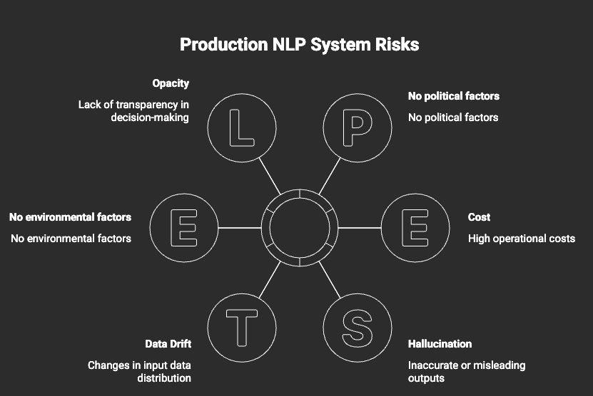
M01.1 BPE
M05
Chapter 5.1 Introduction to Applied NLP Tasks
Production Challenges in Applied NLP
Benchmarks standardize model comparison.
GLUE and SuperGLUE measure reasoning ability.
High benchmark scores ≠ production readiness.
Fine-tuning adapts models to domain-specific tasks.

Slide 11
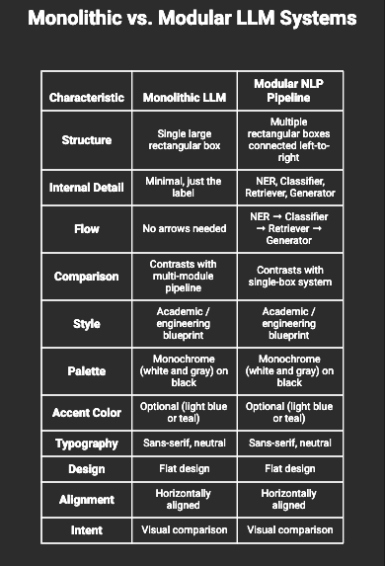
M01.1 BPE
M05
Chapter 5.1 Introduction to Applied NLP Tasks
Modular Pipelines vs End-to-End Models
End-to-End: simpler, faster to prototype
Modular pipelines: more explainable and controllable
Enterprises often combine both approaches
Design choice depends on scale and regulation

Slide 12
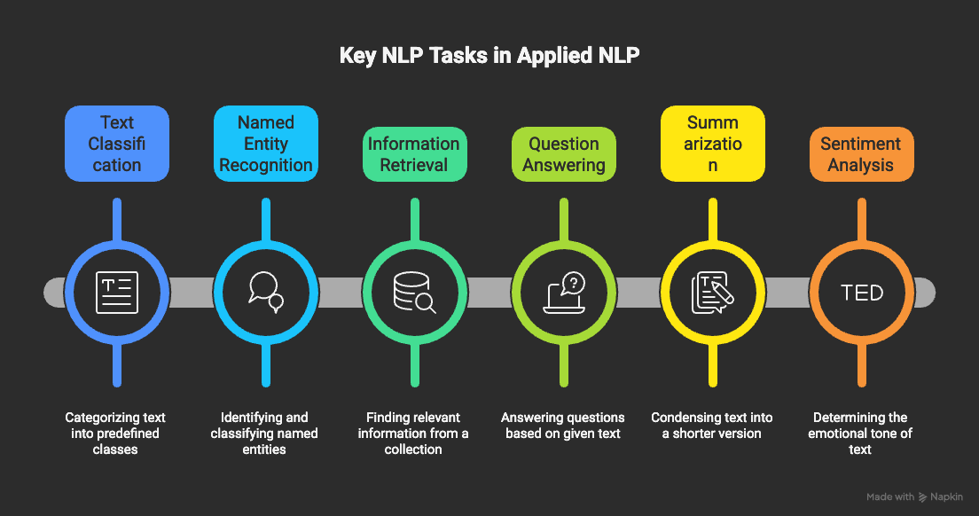
M01.1 BPE
M05
Chapter 5.1 Introduction to Applied NLP Tasks
Why This Module Matters
Applied NLP turns language into action.
Tasks define how AI creates value.
Understanding task structure prevents misuse.
Next chapters deep-dive into each task.

Slide 13
THEORY
Training Program 01
5.1 Introduction to Applied NLP Tasks
5.2 Core Task: Text Classification
5.3 Understanding User Intent: Sentiment Analysis
5.4 Reducing Information Overload: Text Summarization
5.5 Information Retrieval: Question Answering Systems
5.6 Task Comparison and the Future of Applied NLP

Slide 14
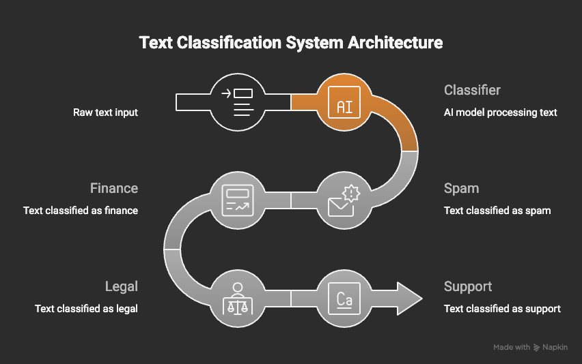
M01.1 BPE
M05
Chapter 5.2 Text Classification
What is Text Classification?
Task: assign predefined labels to text.
One of the oldest and most deployed NLP tasks.
Foundation for moderation, routing, filtering, analytics.
Used in almost every production NLP system.

Slide 15
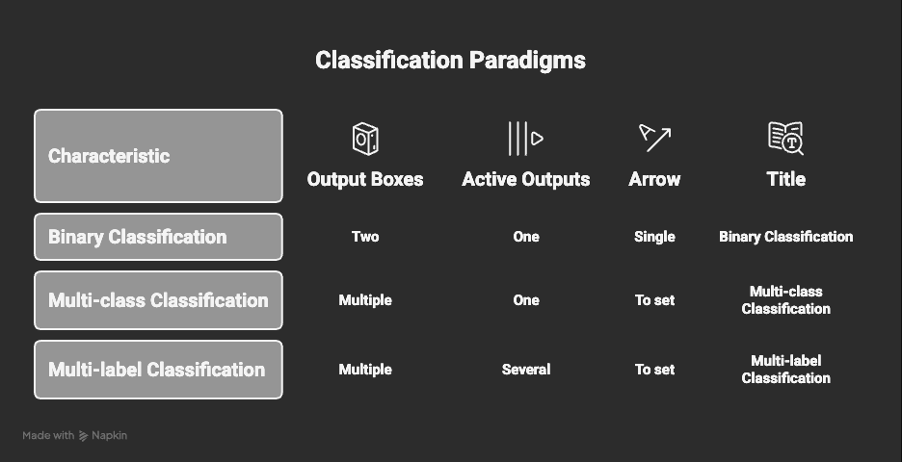
M01.1 BPE
M05
Chapter 5.2 Text Classification
Classification Problem Types
Binary: two exclusive classes (Yes / No)
Multi-class: one label from many
Multi-label: multiple labels per document
Correct framing defines model architecture

Slide 16
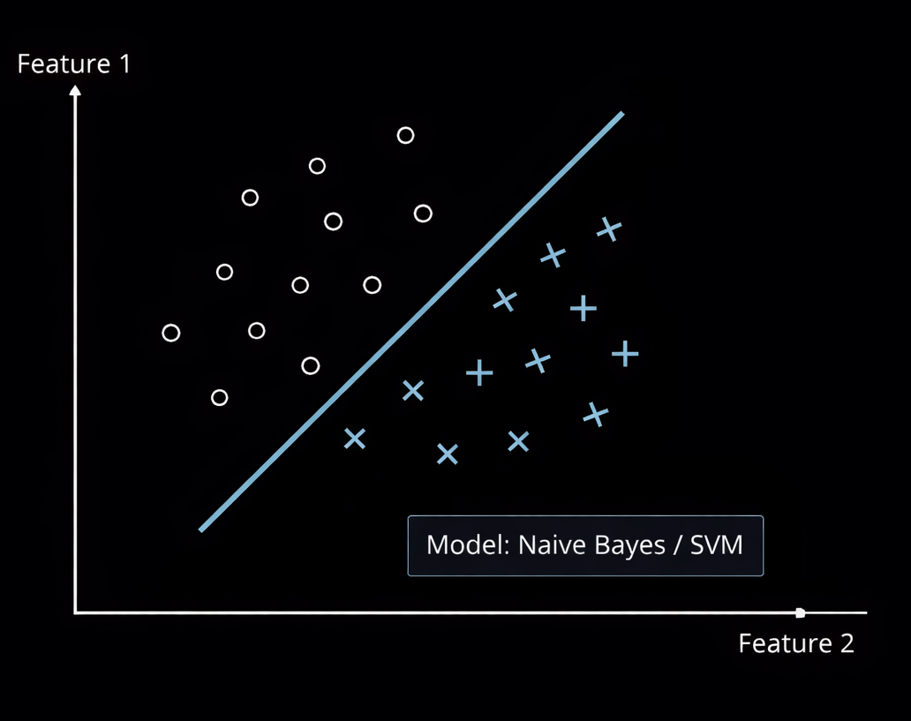
M01.1 BPE
M05
Chapter 5.2 Text Classification
Traditional Classification Methods
Based on word frequency statistics.
Require manual feature engineering.
Still useful for small or structured datasets.
Serve as strong baselines.

Slide 17
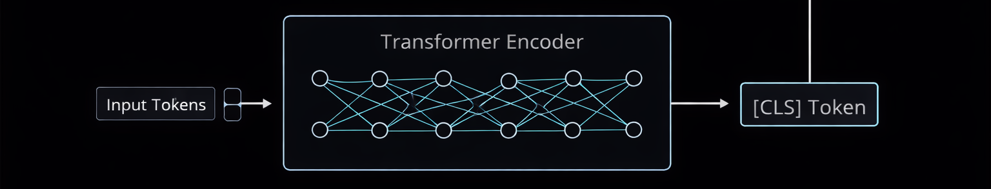
M01.1 BPE
M05
Chapter 5.2 Text Classification
Deep Learning Classification
Models learn features automatically.
Capture semantic meaning, not just keywords.
Transformers are the modern standard.
Context-aware classification.

Slide 18
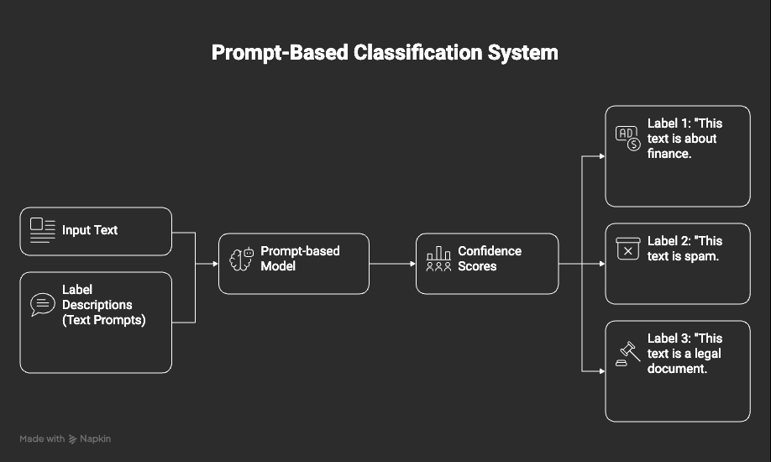
M01.1 BPE
M05
Chapter 5.2 Text Classification
Zero-Shot Classification
No task-specific training required.
Uses natural language label descriptions.
Extremely fast to deploy.
Ideal for dynamic taxonomies.

Slide 19
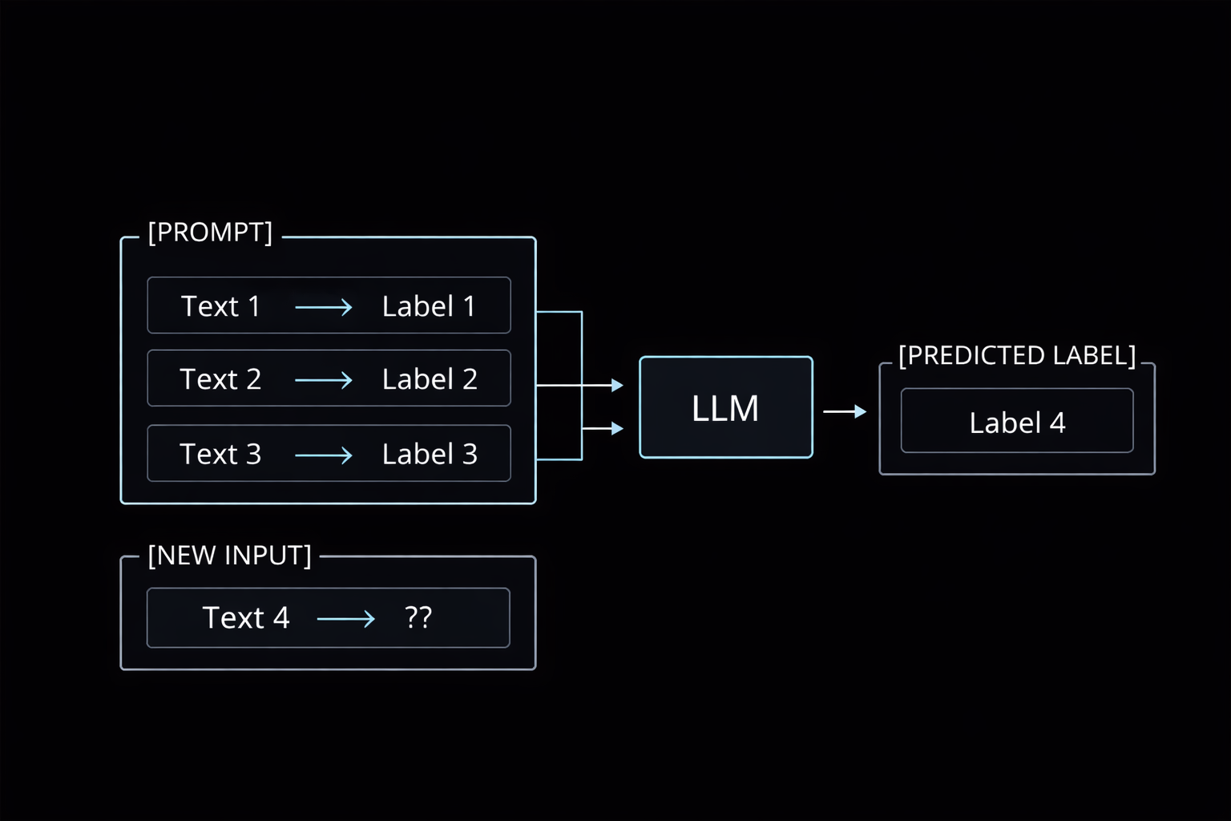
M01.1 BPE
M05
Chapter 5.2 Text Classification
Few-Shot Classification
No task-specific training required
Uses natural language label descriptions
Extremely fast to deploy
Ideal for dynamic taxonomies

Slide 20
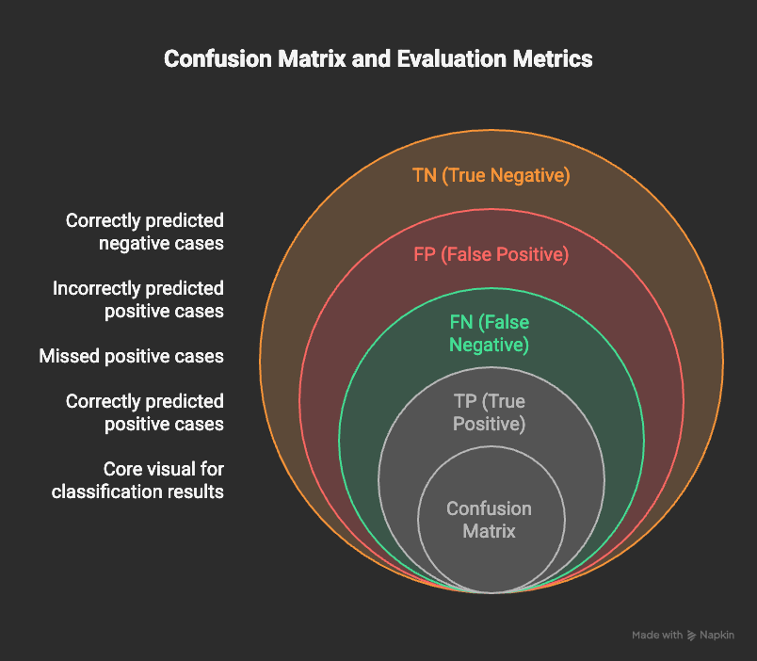
M01.1 BPE
M05
Chapter 5.2 Text Classification
Evaluation Metrics
Accuracy is often misleading
Precision controls false positives
Recall controls false negatives
F1-score balances both
Metric choice depends on risk

Slide 21
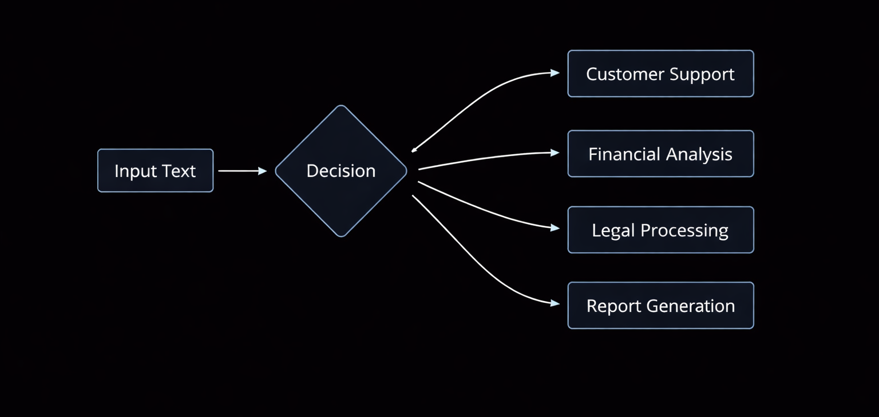
M01.1 BPE
M05
Chapter 5.2 Text Classification
Key Takeaways
Classification transforms language into decisions
Architecture choice matters more than model size
Zero-shot enables rapid deployment
Metrics define real-world success

Slide 22
THEORY
Training Program 01
5.1 Introduction to Applied NLP Tasks
5.2 Core Task: Text Classification
5.3 Understanding User Intent: Sentiment Analysis
5.4 Reducing Information Overload: Text Summarization
5.5 Information Retrieval: Question Answering Systems
5.6 Task Comparison and the Future of Applied NLP

Slide 23
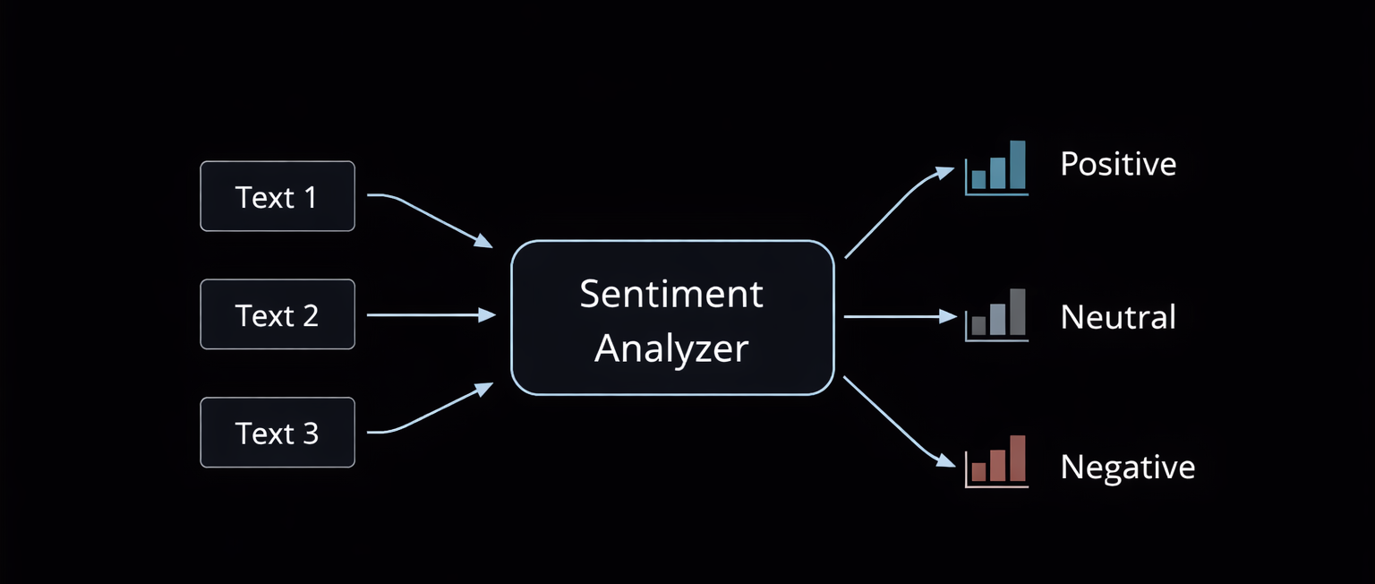
M01.1 BPE
M05
Chapter 5.3 Understanding User Intent: Sentiment Analysis
What is Sentiment Analysis?
Task: detect subjective intent in text
Focuses on opinions, emotions, attitudes
Specialized form of text classification
Core signal for user and market intelligence

Slide 24
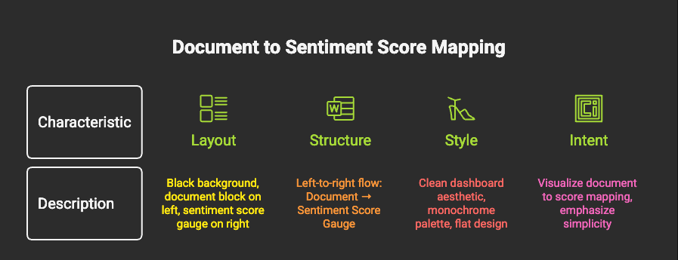
M01.1 BPE
M05
Chapter 5.3 Understanding User Intent: Sentiment Analysis
Document-Level Sentiment
One sentiment for the entire document
Simple and computationally efficient
Works well for short reviews or posts
Loses internal nuance

Slide 25
M01.1 BPE
M05
Chapter 5.3 Understanding User Intent: Sentiment Analysis
Document-Level Sentiment
One sentiment for the entire document
Simple and computationally efficient
Works well for short reviews or posts
Loses internal nuance

Slide 26
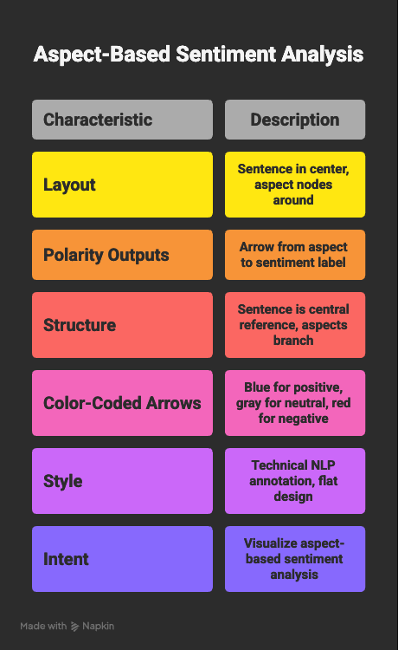
M01.1 BPE
M05
Chapter 5.3 Understanding User Intent: Sentiment Analysis
Aspect-Based Sentiment Analysis (ABSA)
Sentiment linked to specific entities or features
Enables fine-grained insight
Essential for product and brand analysis
Industry standard for actionable feedback

Slide 27
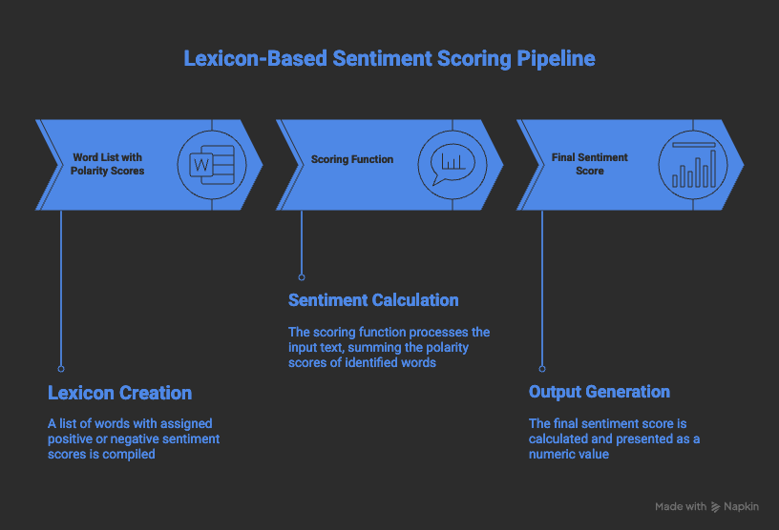
M01.1 BPE
M05
Chapter 5.3 Understanding User Intent: Sentiment Analysis
Lexicon-Based Approaches
Use predefined polarity dictionaries
Fully explainable
Fast and lightweight
Fail under context, irony, or negation

Slide 28
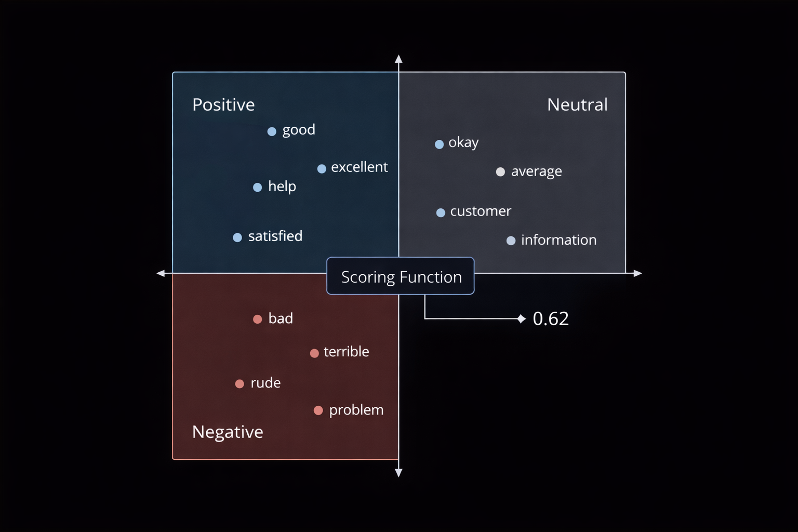
M01.1 BPE
M05
Chapter 5.3 Understanding User Intent: Sentiment Analysis
Embedding-Based Sentiment Models
Meaning represented in latent vector space
Generalizes beyond exact keywords
Robust to synonyms and paraphrases
Foundation for transformer-based sentiment

Slide 29
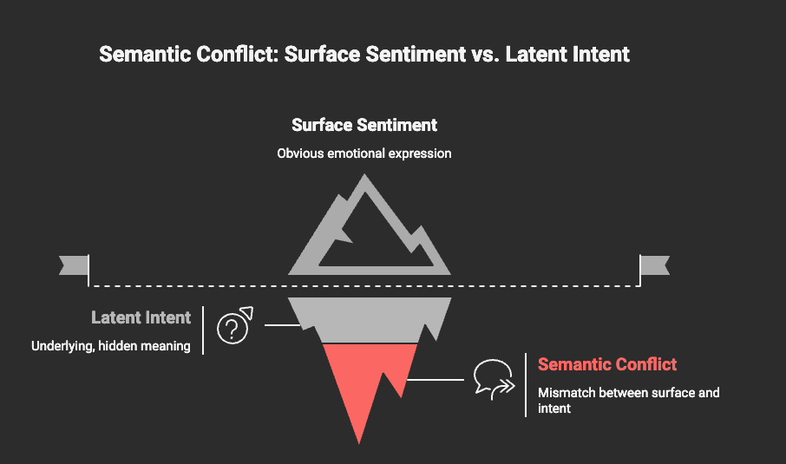
M01.1 BPE
M05
Chapter 5.3 Understanding User Intent: Sentiment Analysis
Negation and Sarcasm Challenges
Negation flips polarity meaning
Sarcasm contradicts surface wording
Requires long-range context
Transformers outperform classical models

Slide 30
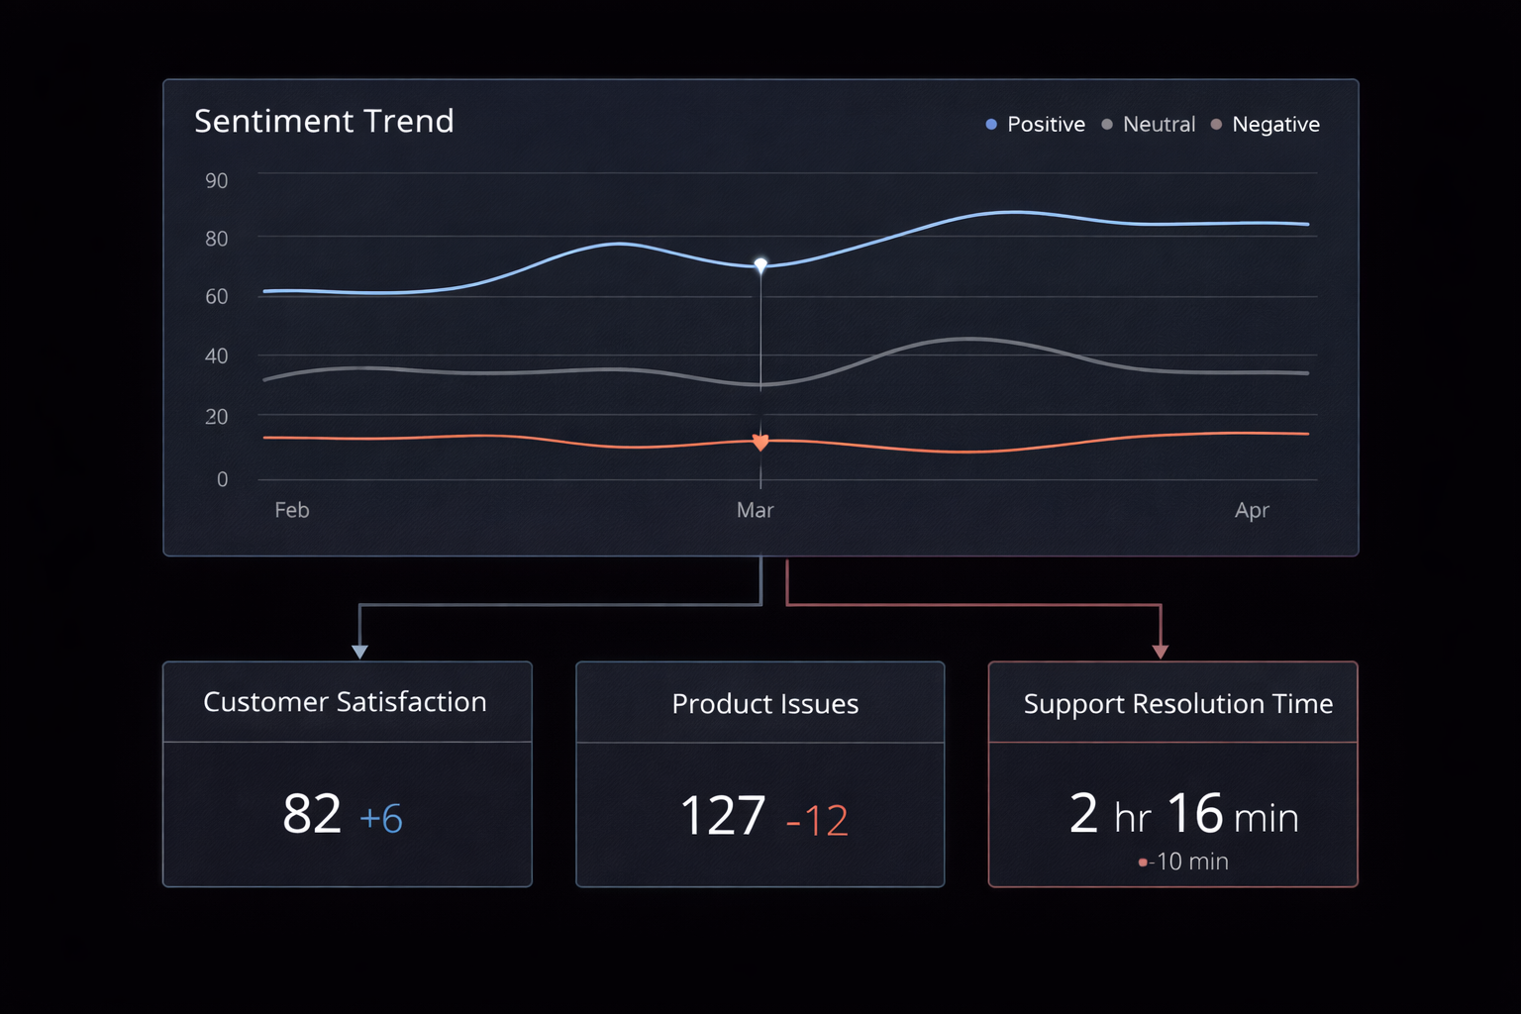
M01.1 BPE
M05
Chapter 5.3 Understanding User Intent: Sentiment Analysis
Sentiment in Market Intelligence
Meaning represented in latent vector space
Generalizes beyond exact keywords
Robust to synonyms and paraphrases
Foundation for transformer-based sentiment

Slide 31
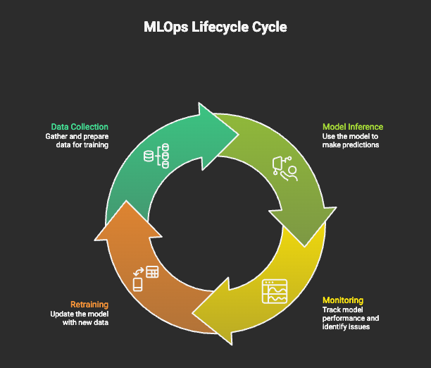
M01.1 BPE
M05
Chapter 5.3 Understanding User Intent: Sentiment Analysis
Operational Considerations
Domain-specific language matters
Models degrade with cultural drift
Requires periodic re-evaluation
Sentiment ≠ truth

Slide 32
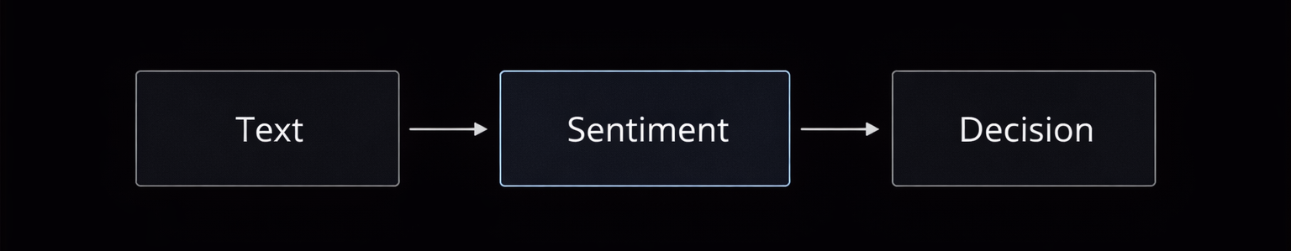
M01.1 BPE
M05
Chapter 5.3 Understanding User Intent: Sentiment Analysis
Key Takeaways
Sentiment reveals user intent.
Aspect-level analysis enables action.
Context is the main technical challenge.
Critical signal for applied NLP systems.

Slide 33
THEORY
Training Program 01
5.1 Introduction to Applied NLP Tasks
5.2 Core Task: Text Classification
5.3 Understanding User Intent: Sentiment Analysis
5.4 Reducing Information Overload: Text Summarization
5.5 Information Retrieval: Question Answering Systems
5.6 Task Comparison and the Future of Applied NLP

Slide 34
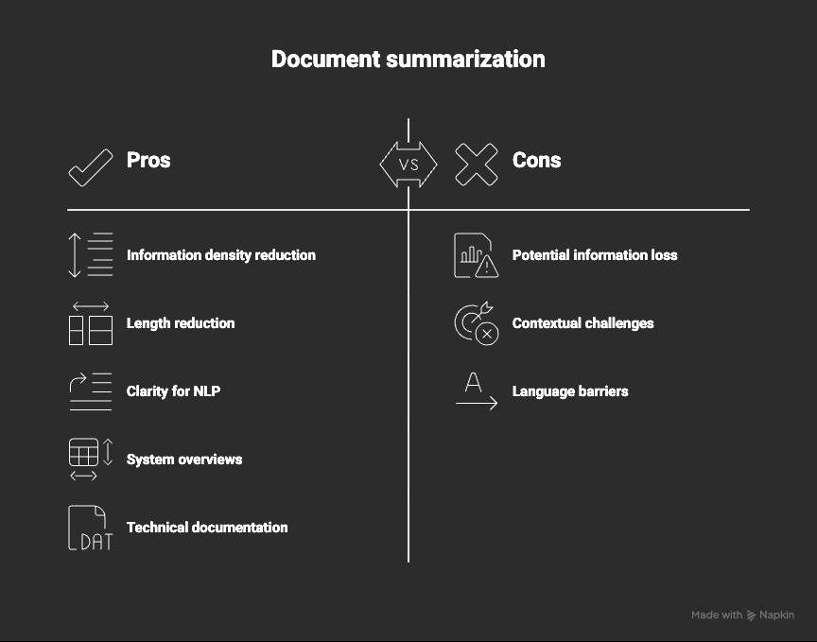
M01.1 BPE
M05
Chapter 5.4 Reducing Information Overload: Text Summarization
What is Text Summarization?
Task: compress long text into key information.
Preserves meaning while reducing length.
Essential for scale and decision speed.
Widely used in legal, news, intelligence.

Slide 35
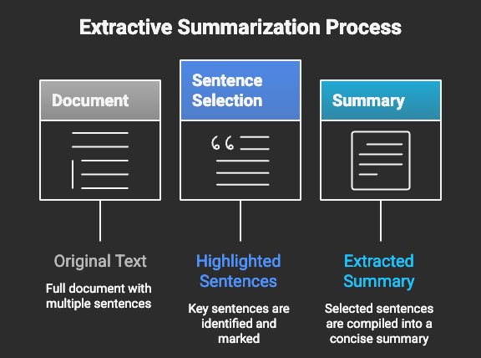
M01.1 BPE
M05
Chapter 5.4 Reducing Information Overload: Text Summarization
Extractive Summarization
Task: compress long text into key information
Preserves meaning while reducing length
Essential for scale and decision speed
Widely used in legal, news, intelligence

Slide 36
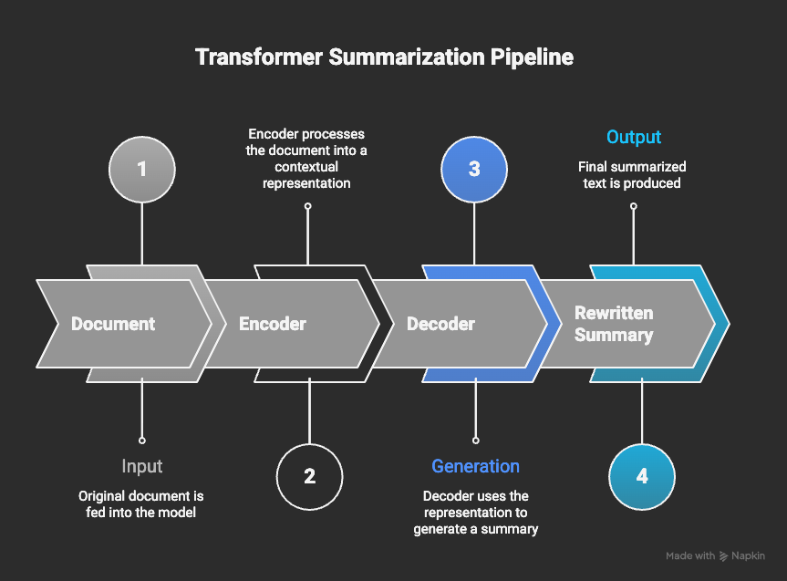
M01.1 BPE
M05
Chapter 5.4 Reducing Information Overload: Text Summarization
Abstractive Summarization
Generates new sentences
Higher information density
More natural language
Risk of hallucination

Slide 37
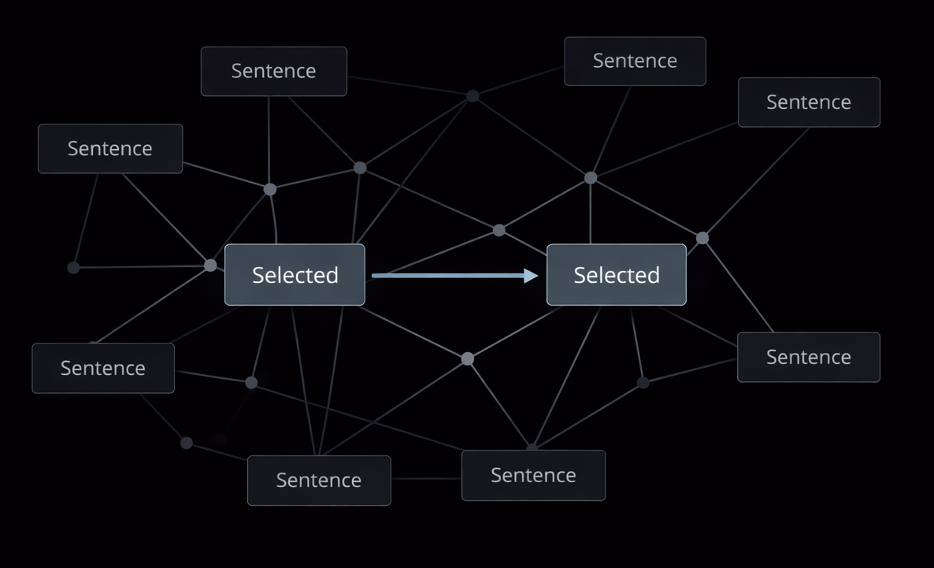
M01.1 BPE
M05
Chapter 5.4 Reducing Information Overload: Text Summarization
Traditional Extractive Techniques
Graph-based ranking (TextRank)
Sentence similarity scoring
No deep semantics
Still useful for formal text

Slide 38
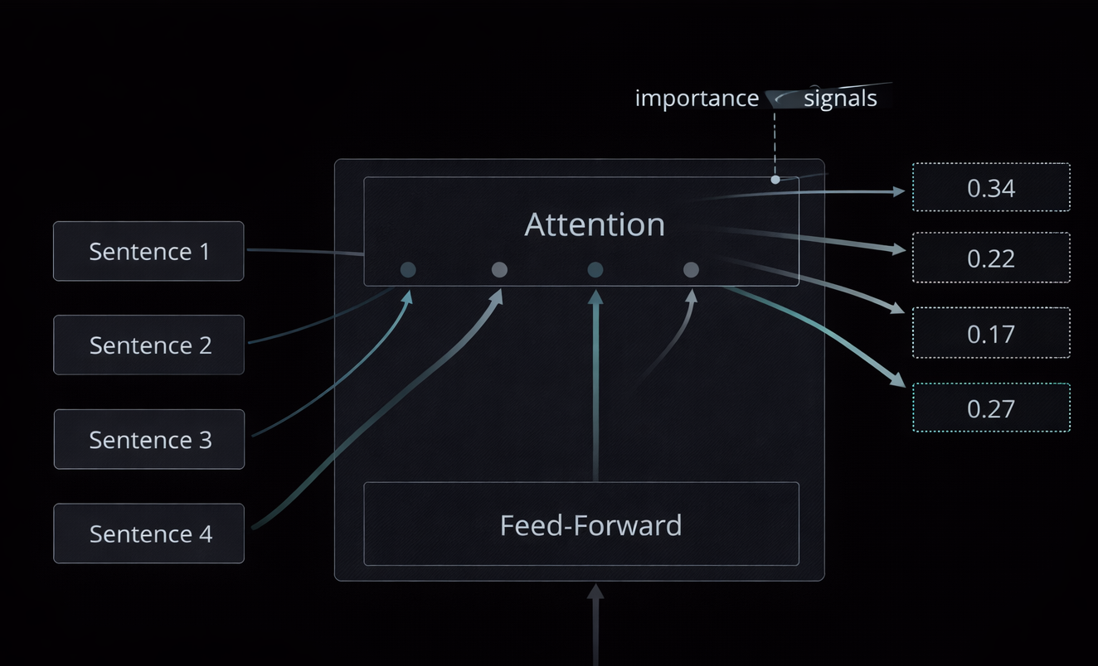
M01.1 BPE
M05
Chapter 5.4 Reducing Information Overload: Text Summarization
Transformer-Based Summarization
Uses full-document context
Learns semantic importance
State-of-the-art performance
Dominant in production systems

Slide 39
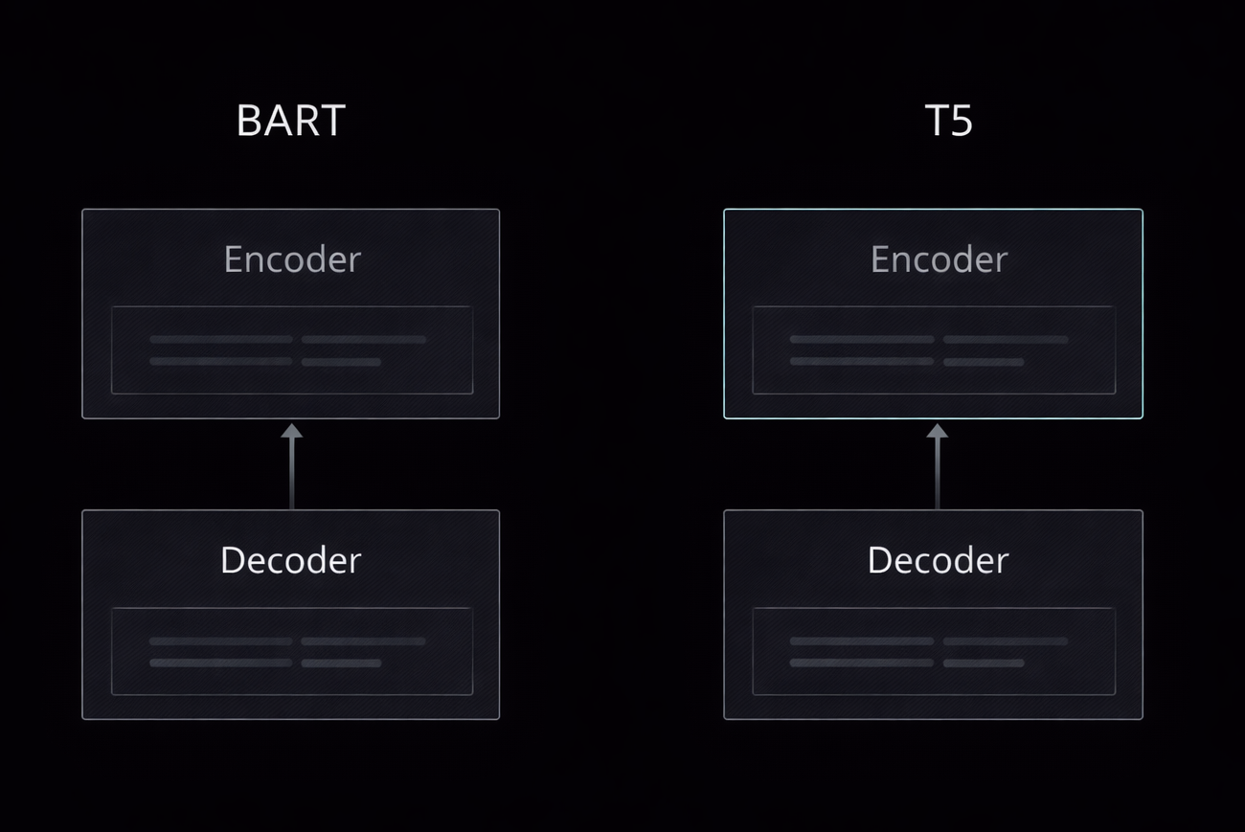
M01.1 BPE
M05
Chapter 5.4 Reducing Information Overload: Text Summarization
BART and T5 Models
UEncoder–Decoder architectures
Pre-trained for text reconstruction
Strong performance on long documents
Industry standard for summarization

Slide 40
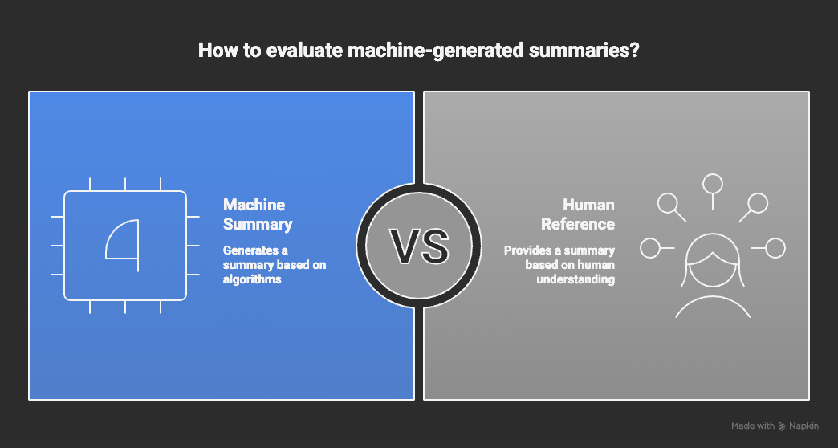
M01.1 BPE
M05
Chapter 5.4 Reducing Information Overload: Text Summarization
Evaluation Metrics (ROUGE)
Measures overlap with human summaries
ROUGE-1, ROUGE-2, ROUGE-L
Focuses on recall
Does not ensure factuality

Slide 41
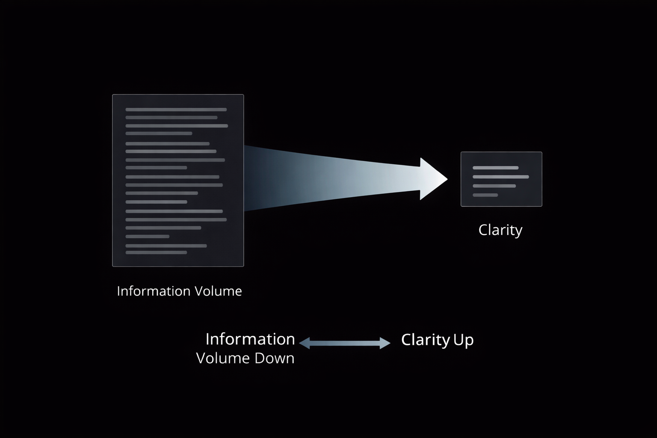
M01.1 BPE
M05
Chapter 5.4 Reducing Information Overload: Text Summarization
Key Takeaways
Summarization manages information overload
Extractive = safer, abstractive = denser
Transformers dominate modern systems

Slide 42
THEORY
Training Program 01
5.1 Introduction to Applied NLP Tasks
5.2 Core Task: Text Classification
5.3 Understanding User Intent: Sentiment Analysis
5.4 Reducing Information Overload: Text Summarization
5.5 Information Retrieval: Question Answering Systems
5.6 Task Comparison and the Future of Applied NLP

Slide 43
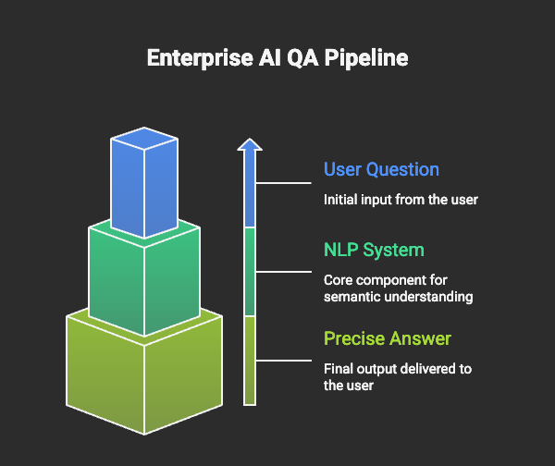
M01.1 BPE
M05
Chapter 5.5 Information Retrieval: Question Answering Systems
What is Question Answering (QA)?
Goes beyond keyword search
Requires language understanding
Core of modern AI assistants

Slide 44
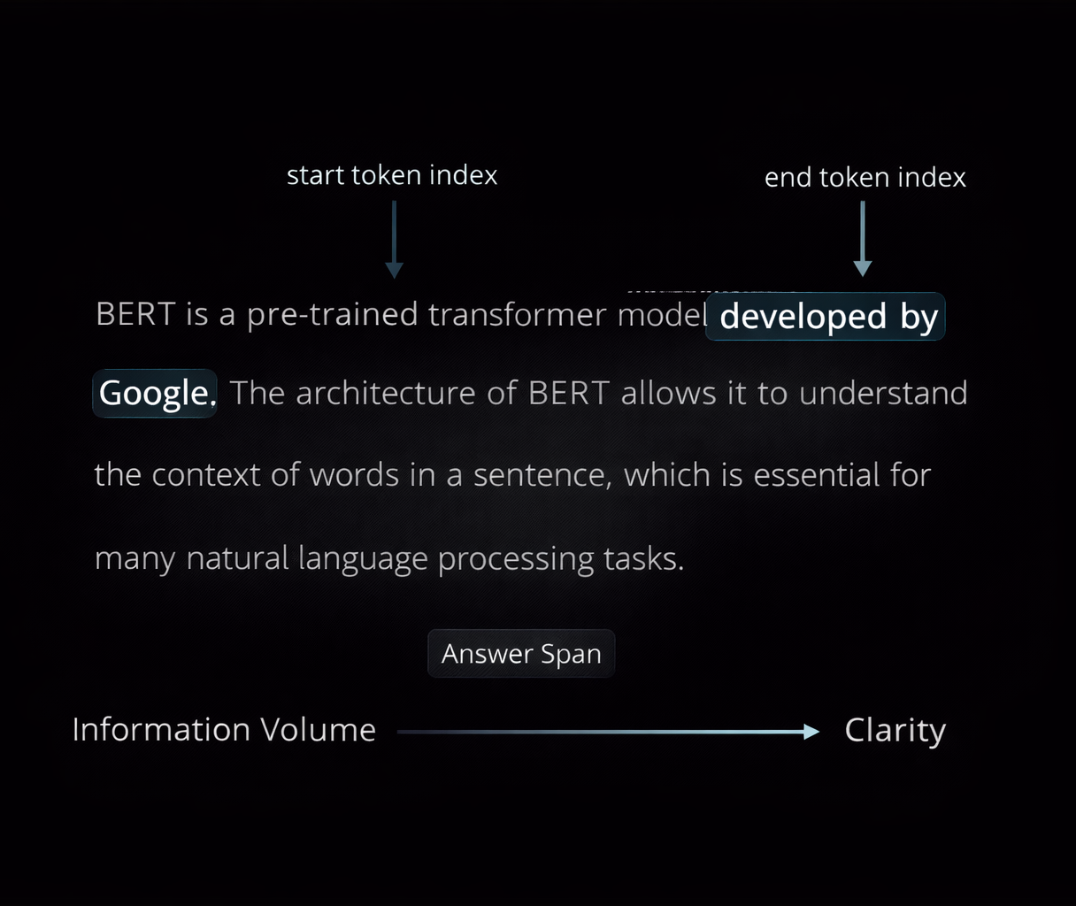
M01.1 BPE
M05
Chapter 5.5 Information Retrieval: Question Answering Systems
Extractive Question Answering
Answer is a text span
Start and end token prediction
High factual precision
Limited to provided context

Slide 45
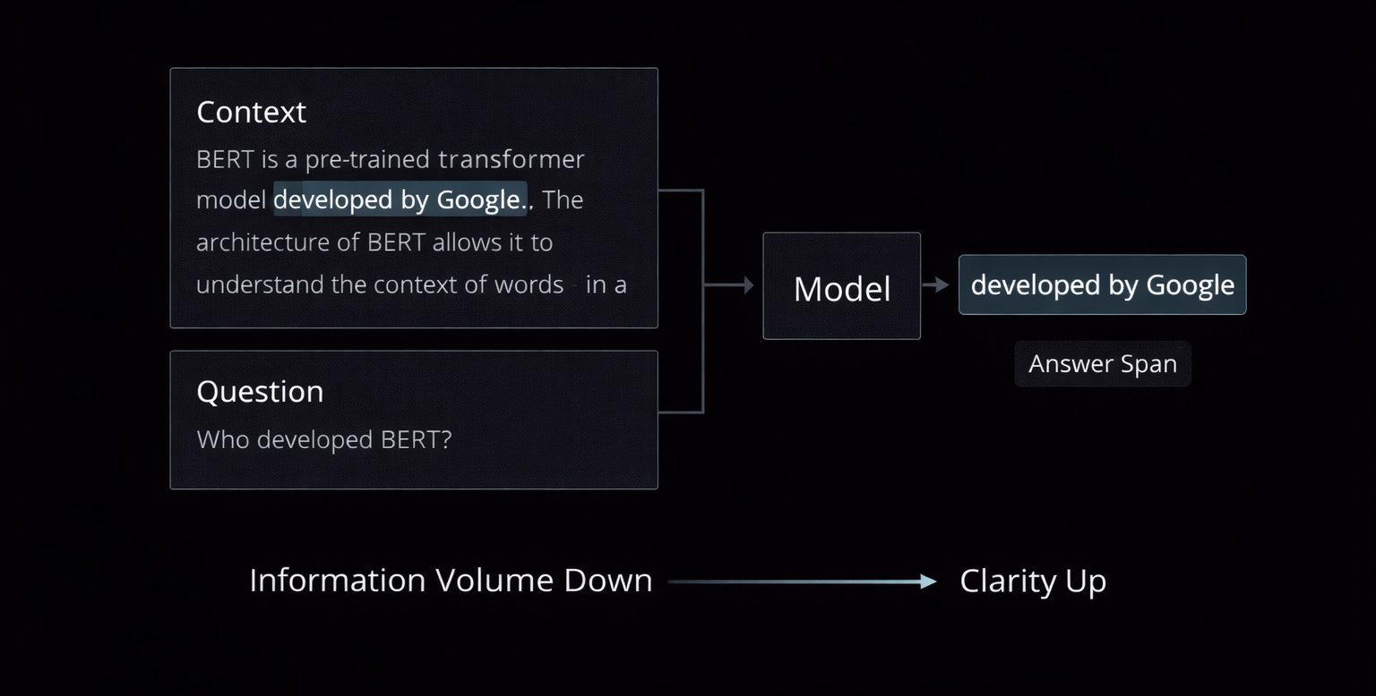
M01.1 BPE
M05
Chapter 5.5 Information Retrieval: Question Answering Systems
The SQuAD Paradigm
Benchmark dataset for extractive QA
Context + Question → Span
Enabled large-scale QA training
Foundation for enterprise FAQ systems

Slide 46
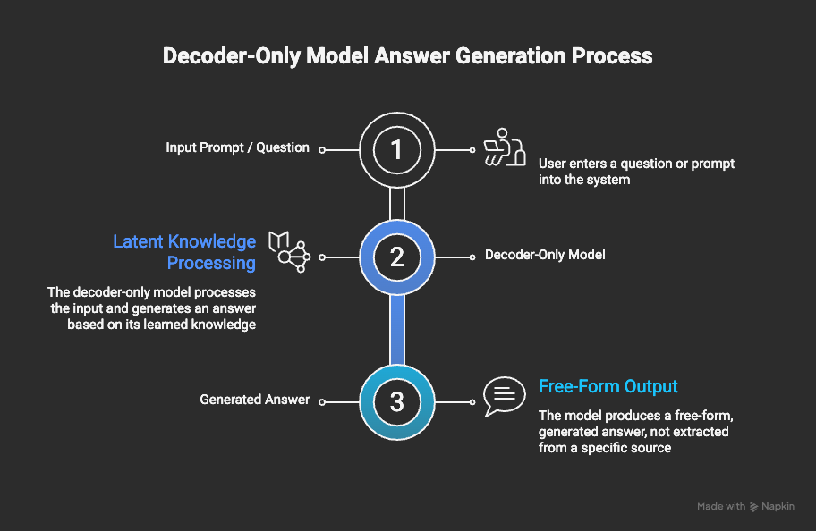
M01.1 BPE
M05
Chapter 5.5 Information Retrieval: Question Answering Systems
Generative Question Answering
Benchmark dataset for extractive QA
Context + Question → Span
Enabled large-scale QA training
Foundation for enterprise FAQ systems

Slide 47
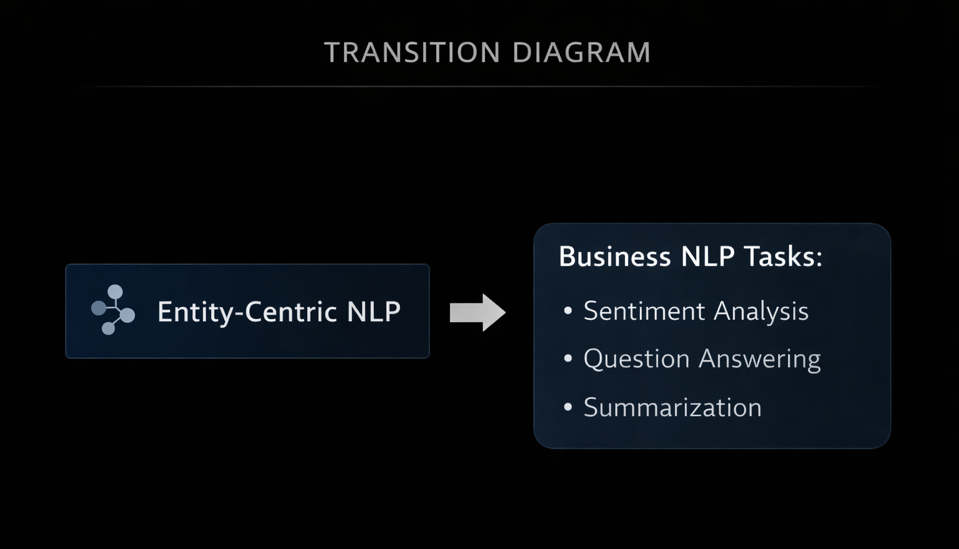
M01.1 BPE
M05
Chapter 5.5 Information Retrieval: Question Answering Systems
Knowledge-Based Question Answering
Uses structured databases
Converts language to queries
Deterministic answers
High reliability systems

Slide 48
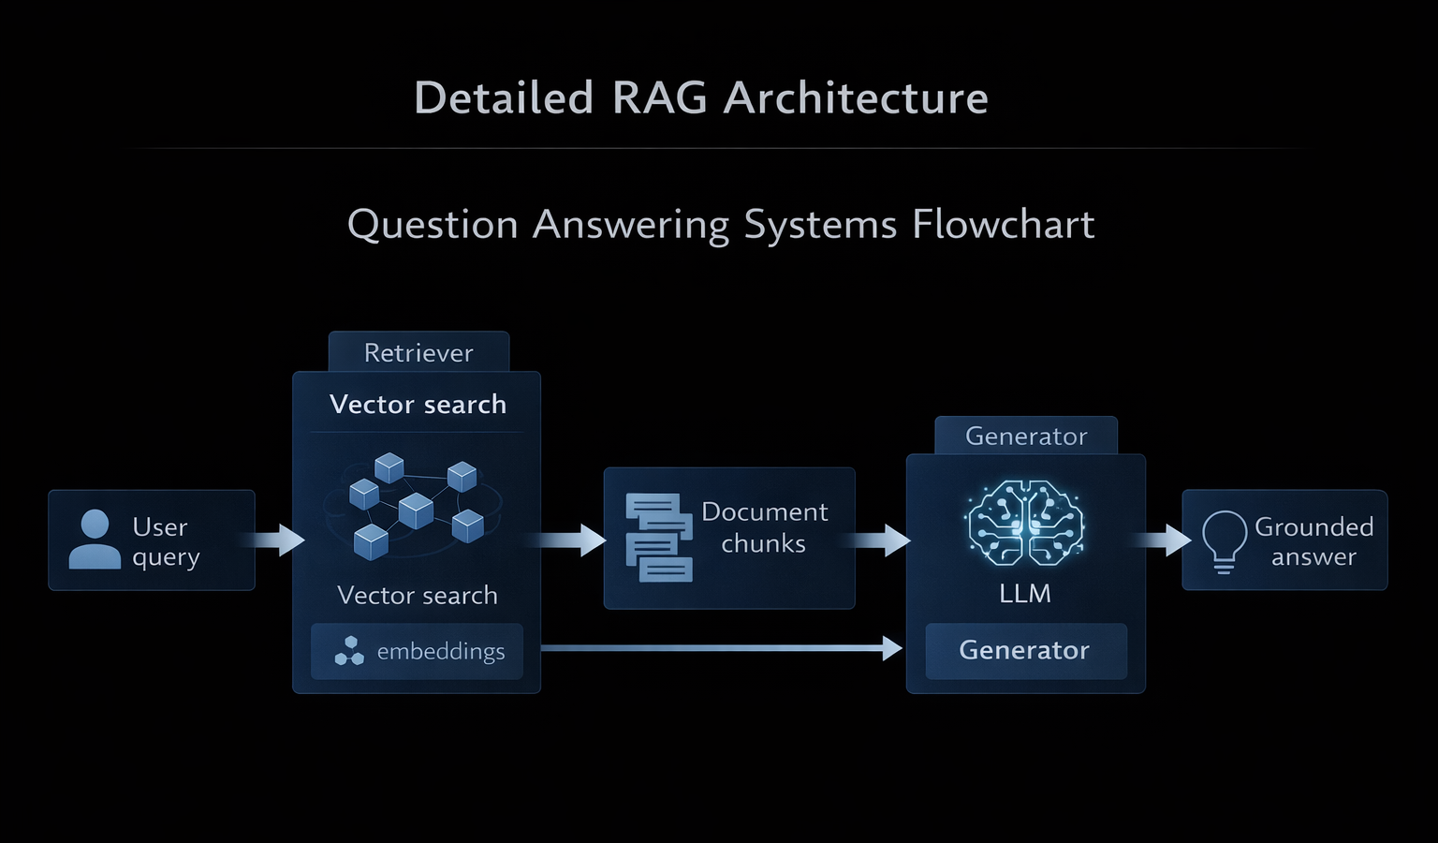
M01.1 BPE
M05
Chapter 5.5 Information Retrieval: Question Answering Systems
Retrieval-Augmented Generation (RAG)
Industry-standard QA architecture
Combines retrieval + generation
Uses private documents
Reduces hallucinations

Slide 49
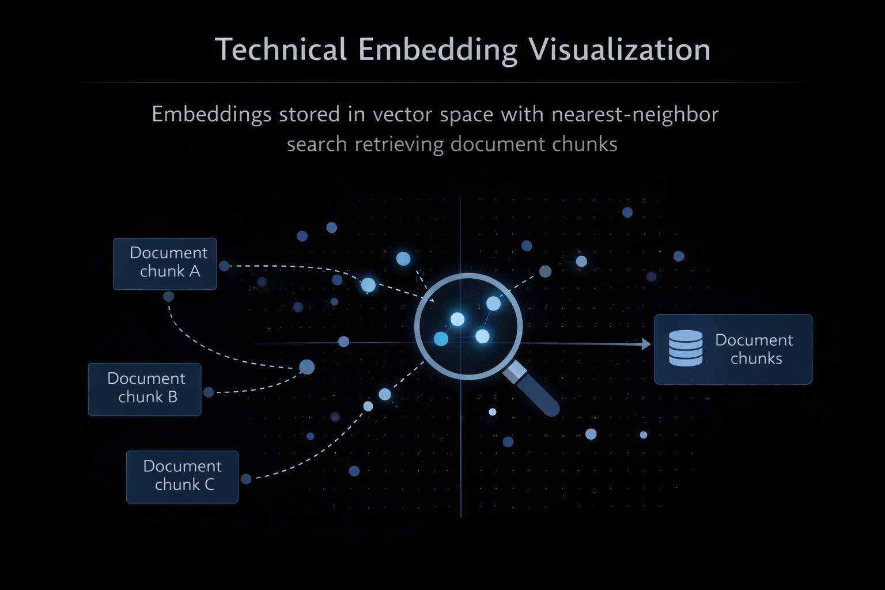
M01.1 BPE
M05
Chapter 5.5 Information Retrieval: Question Answering Systems
Vector Databases in QA
Exact Match (EM)
F1-Score (span overlap)
Faithfulness (RAG-specific)
Citation correctness

Slide 50
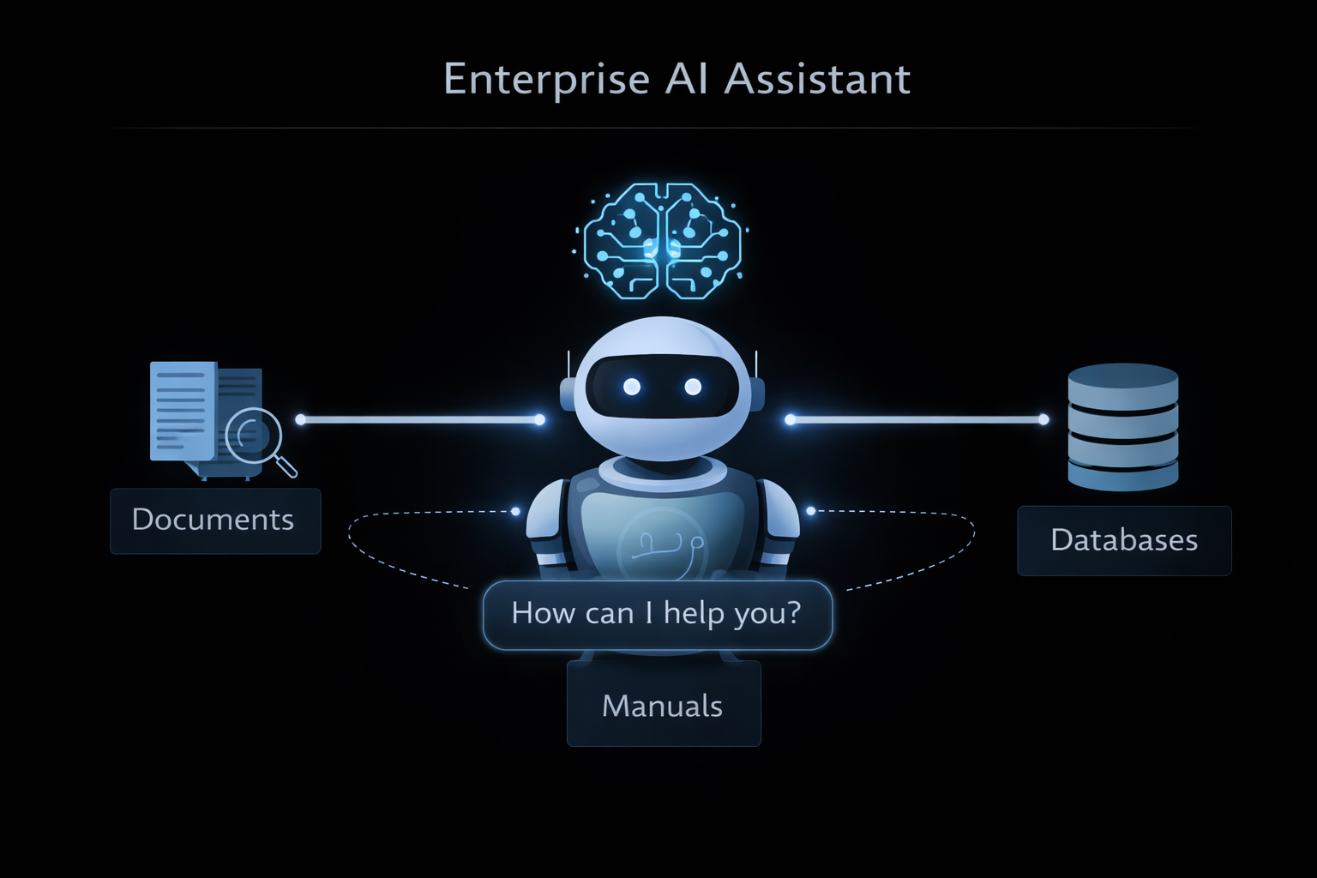
M01.1 BPE
M05
Chapter 5.5 Information Retrieval: Question Answering Systems
Evaluation Metrics for QA
Customer support automation
Technical documentation search
Legal and medical assistants
Enterprise knowledge access

Slide 51
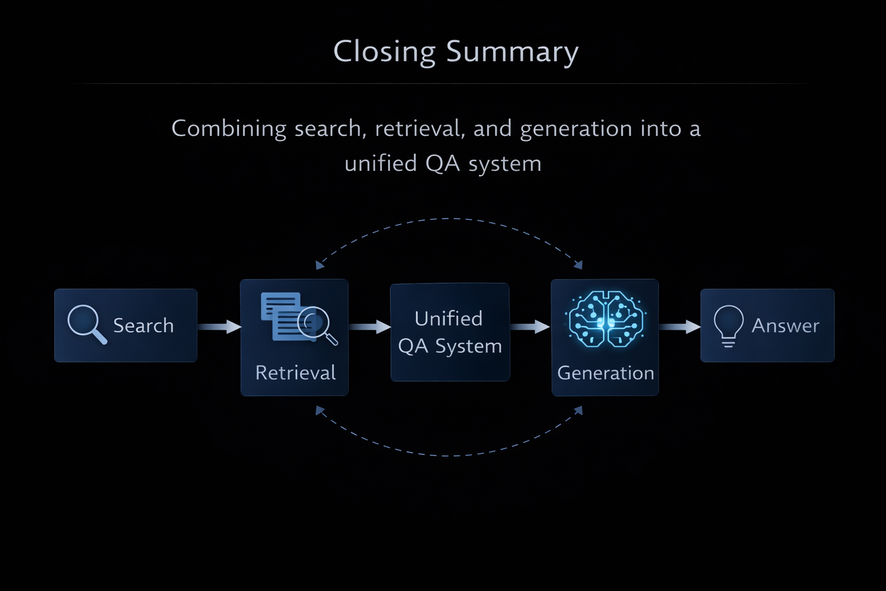
M01.1 BPE
M05
Chapter 5.5 Information Retrieval: Question Answering Systems
Key Takeaways
Customer support automation
Technical documentation search
Legal and medical assistants
Enterprise knowledge access

Slide 52
THEORY
Training Program 01
5.1 Introduction to Applied NLP Tasks
5.2 Core Task: Text Classification
5.3 Understanding User Intent: Sentiment Analysis
5.4 Reducing Information Overload: Text Summarization
5.5 Information Retrieval: Question Answering Systems
5.6 Task Comparison and the Future of Applied NLP

Slide 53
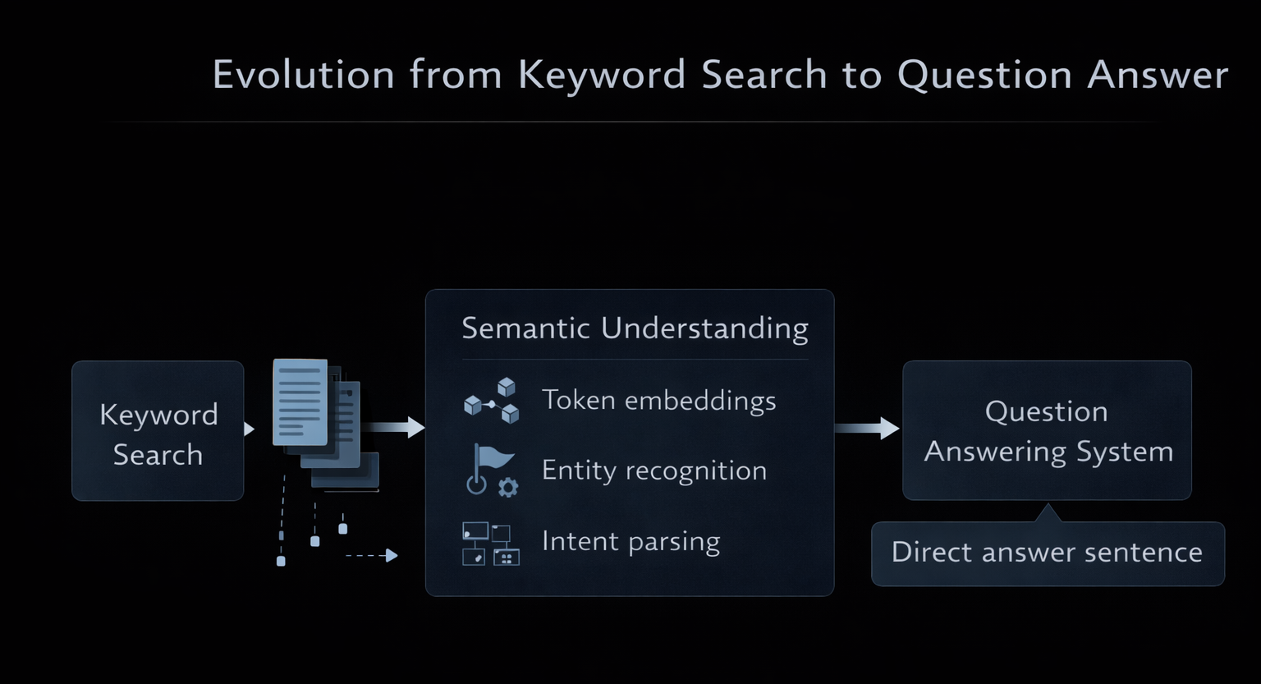
M01.1 BPE
M05
Chapter 5.6 Task Comparison and the Future of Applied NLP
What is Question Answering?
Customer support automation
Technical documentation search
Legal and medical assistants
Enterprise knowledge access

Slide 54
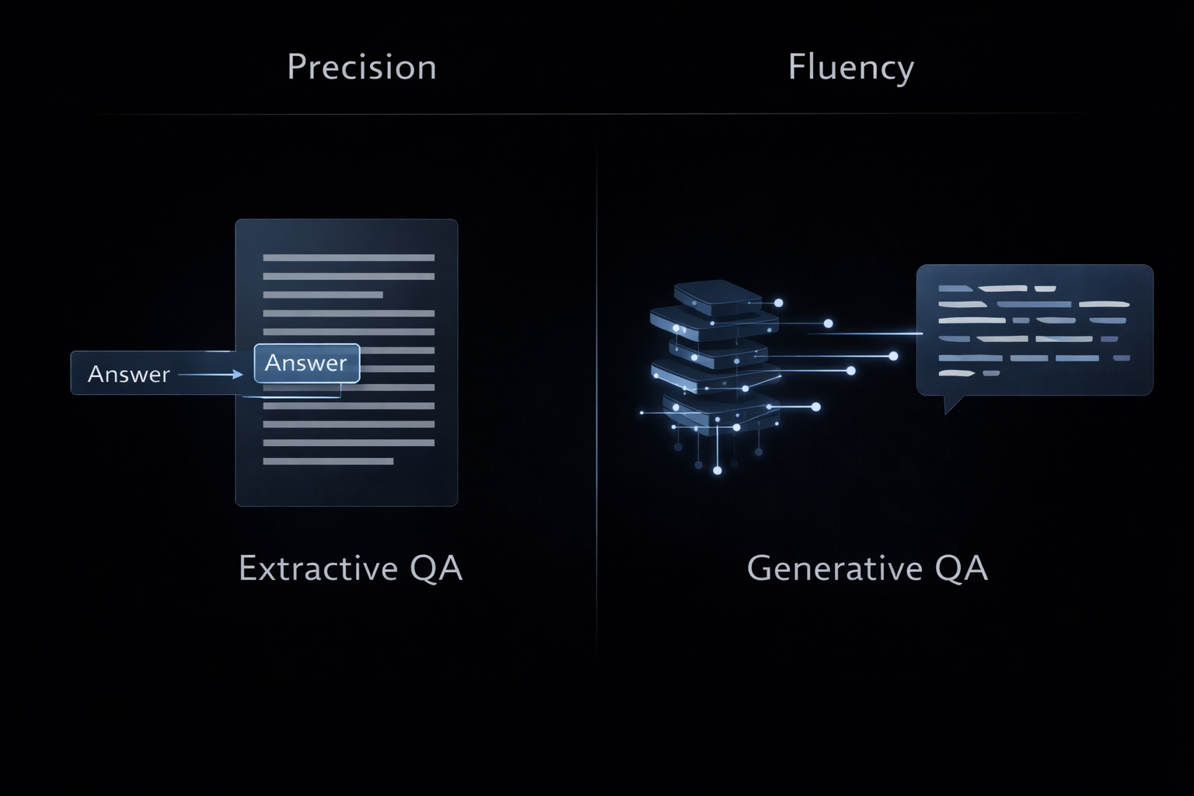
M01.1 BPE
M05
Chapter 5.6 Task Comparison and the Future of Applied NLP
Extractive vs Generative QA
QA systems operate under two main paradigms: extracting exact answers from text or generating new answers using language models.
Extractive: answer is a text span
High factual precision
Used in legal and technical domains
Generative: produces new text
More fluent, higher hallucination risk

Slide 55
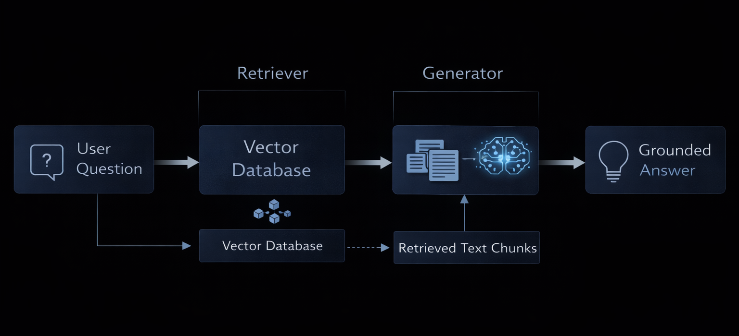
M01.1 BPE
M05
Chapter 5.6 Task Comparison and the Future of Applied NLP
Retrieval-Augmented Generation (RAG)
Retrieval-Augmented Generation (RAG) combines document retrieval with generative models to produce answers grounded in real data.
Industry standard for QA
Uses vector search
Injects retrieved text into prompts
Reduces hallucinations
Enables private data QA

Slide 56
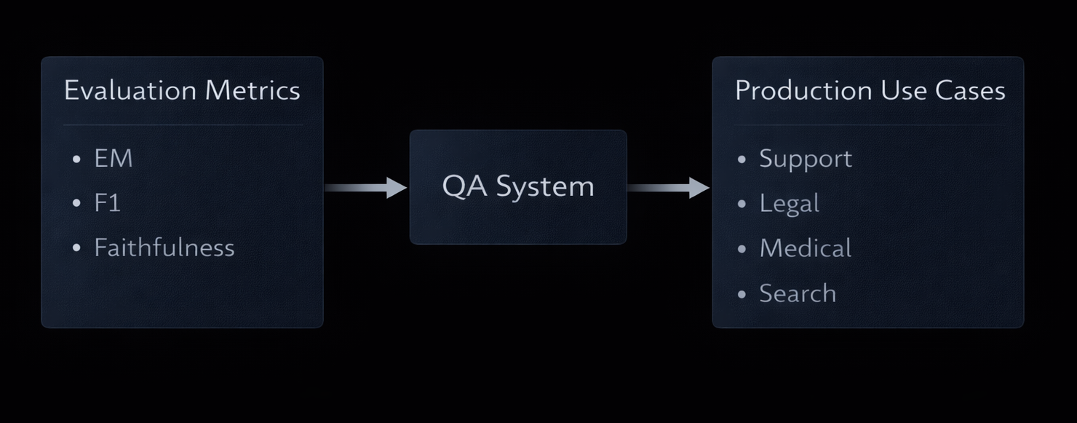
M01.1 BPE
M05
Chapter 5.6 Task Comparison and the Future of Applied NLP
Evaluation and Production Use
Reliable QA systems must be evaluated not only for correctness, but also for trust and factual grounding.
Exact Match (EM)
F1-score (span overlap)
Faithfulness (RAG answers)
Enterprise QA systems
Trust and explainability

Slide 57
M01.1 BPE
M05
Resources & Academic References
Core Benchmarks & Tasks
Wang et al. (2018) — GLUE: A Multi-Task Benchmark for Natural Language Understanding
https://arxiv.org/abs/1804.07461
Wang et al. (2019) — SuperGLUE: A Stickier Benchmark for General-Purpose Language Understanding Systems
https://arxiv.org/abs/1905.00537
Rajpurkar et al. (2016) — SQuAD: 100,000+ Questions for Machine Comprehension of Text
https://arxiv.org/abs/1606.05250
Text Classification & Zero-Shot Learning
Cortes & Vapnik (1995) — Support-Vector Networks
https://link.springer.com/article/10.1007/BF00994018
Yin et al. (2019) — Benchmarking Zero-shot Text Classification
https://arxiv.org/abs/1909.00161

Slide 58
M01.1 BPE
M05
Resources & Academic References
Sentiment Analysis
Pang & Lee (2008) — Opinion Mining and Sentiment Analysis
https://www.cs.cornell.edu/home/llee/omsa/omsa.pd
Pontiki et al. (2014) — SemEval-2014 Task 4: Aspect-Based Sentiment Analysis
https://aclanthology.org/S14-2004.pdf
Text Summarization
Barzilay & Elhadad (1997) — Using Lexical Chains for Text Summarization
https://aclanthology.org/P97-1002.pdf
Lewis et al. (2019) — BART: Denoising Sequence-to-Sequence Pre-training
https://arxiv.org/abs/1910.13461
Raffel et al. (2019) — Exploring the Limits of Transfer Learning with a Unified Text-to-Text Transformer (T5)
https://arxiv.org/abs/1910.10683

Slide 59
M01.1 BPE
M05
Resources & Academic References
Question Answering & RAG
Lewis et al. (2020) — Retrieval-Augmented Generation for Knowledge-Intensive NLP Tasks
https://arxiv.org/abs/2005.11401
Ethics & Future of Applied NLP
Bender et al. (2021) — On the Dangers of Stochastic Parrots
https://dl.acm.org/doi/pdf/10.1145/3442188.3445922
Bommasani et al. (2021) — On the Opportunities and Risks of Foundation Models
https://arxiv.org/abs/2108.07258

